Slide 1






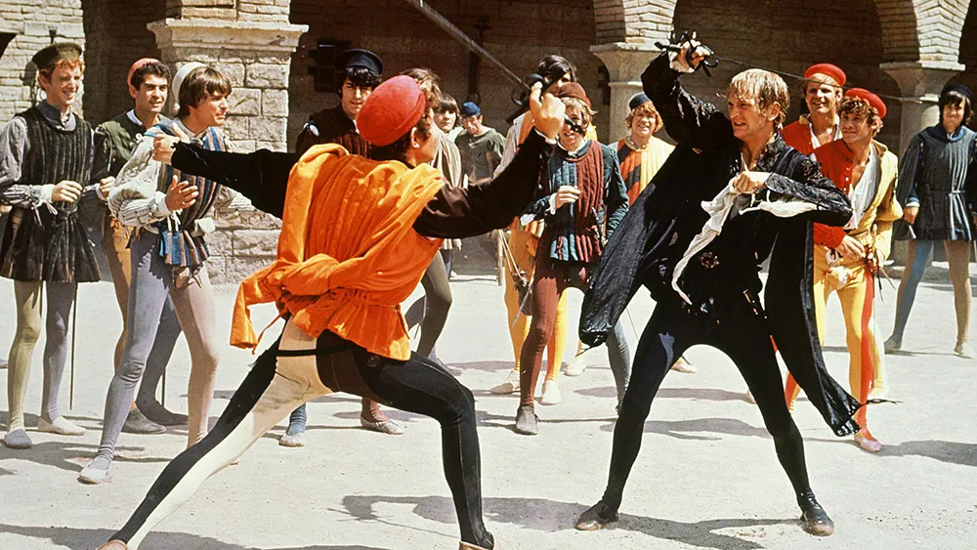

IGCSE R&J WL Coursework
Shakespeare’s
Romeo
and
Juliet
STUDENT R&J READING LOG

Slide 2






World Literature:
Coursework - 33.3%
Empathic Writing - Romeo and Juliet
(Studied and completed at the end of Y10)
Critical Essay - Romeo and Juliet
Complete the R&J Reading Log to the best of your ability. The quotations and notes you make will help you significantly with both your R&J Empathic Writing and R&J Critical Essay
Reader’s Notebook
Lined Notebook - Get used to handwriting!
Romeo & Juliet - PHYSICAL COPY
Reader’s Notebook - for actively reading the texts
1 A4 FOLDER for handouts/worksheets
PEN (NO pencil); at least 3 highlighters
Required Texts
Romeo and Juliet
Cambridge University Press
ISBN: 9781107615403
Students will use this text to write their Critical Essay
coursework.
MUST HAVE

Slide 3
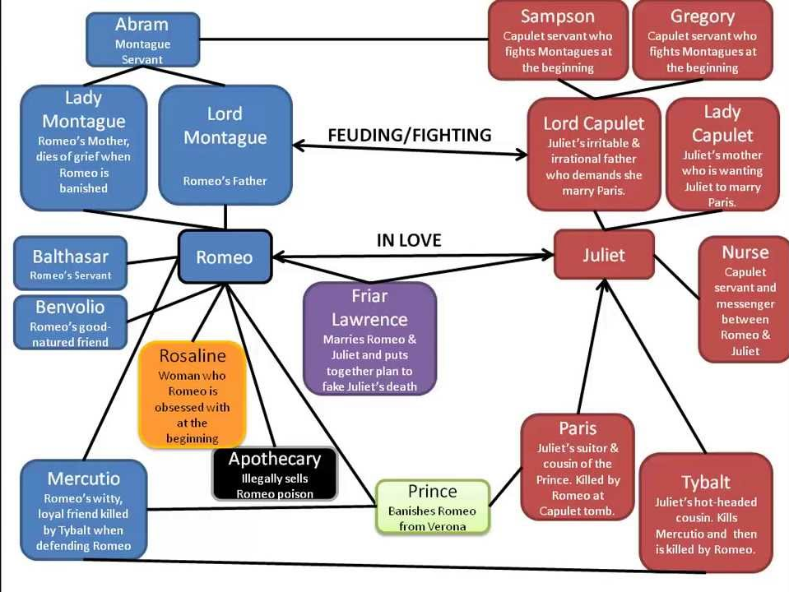
Romeo and Juliet Character Map
Montagues:
Lord Montague
Lady Montague
Romeo
Benvolio
Balthasar
Not Montague/Capulet:
Mercutio
(friend to Romeo)
Prince Escalus
Friar Lawrence
Apothecary
Paris
(Juliet’s suitor)
Capulets:
Lord Capulet
Lady Capulet
Juliet
Tybalt
Nurse
Rosaline
Sampson
Gregory

Slide 4
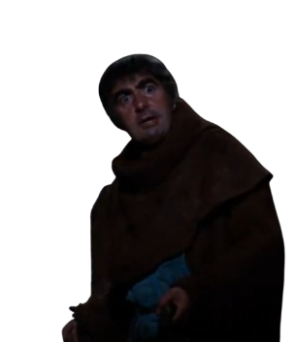
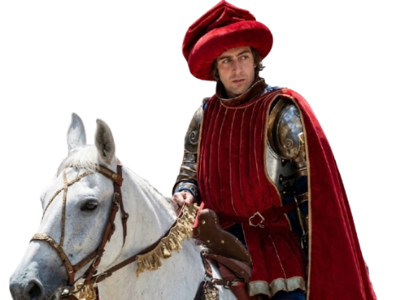
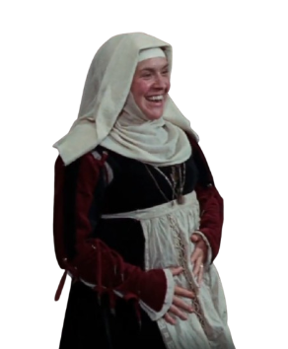


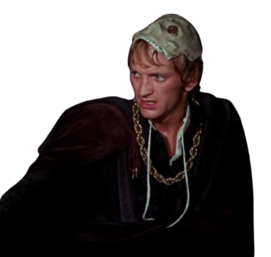
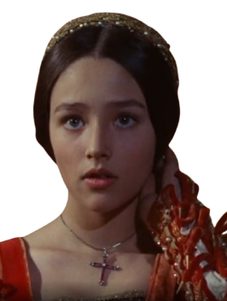
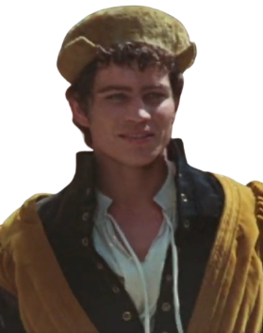

Prince Escalus
Benvolio
Romeo
Mercutio
Juliet
Tybalt
Romeo and Juliet 1968
Zeffirelli -Main Cast-
Friar Lawrence
Nurse
Balthazar
MONTAGUES
CAPULETS

Slide 5
Romeo and Juliet Prologue

Slide 6
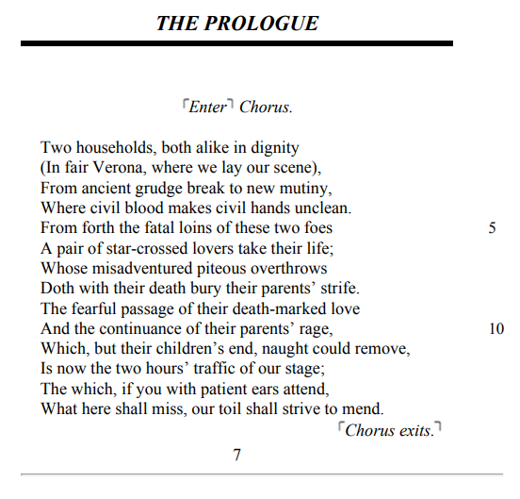
Reading Log: Prologue
Key Quotations: | My thoughts:

Slide 7
Romeo and Juliet ACT 1
Act 1, Scene 1 - Act 1, Scene 5

Slide 8
Reading Log: Act 1, Scene 1
Setting: | Key Quotations: | My thoughts:
Prince Escalus’ Decree* | “Cankered with peace, to part your cankered hate. / If ever you disturb our streets again, / Your lives shall pay the forfeit of the peace” | Violence and duels with swords are now forbidden. Penalty: Death
Verona
Characters: | Key Quotations: | My thoughts:
Romeo
Benvolio
Tybalt

Slide 9
Reading Log: Act 1, Scene 2
Setting: | Key Quotations: | My thoughts:
Capulet Home
Verona
Characters: | Key Quotations: | My thoughts:
Lord Capulet
Paris
Juliet

Slide 10
Reading Log: Act 1, Scene 3
Setting: | Key Quotations: | My thoughts:
Capulet Home
Verona
Characters: | Key Quotations: | My thoughts:
Juliet
Nurse
Rosaline → Romeo’s Initial Love

Slide 11
Reading Log: Act 1, Scene 4
Setting: | Key Quotations: | My thoughts:
Queen Mab Speech* Mercutio Cheering up Romeo*
Capulet Ball (Party)
Characters: | Key Quotations: | My thoughts:
Mercutio
Romeo
Benvolio

Slide 12
Reading Log: Act 1, Scene 5
Setting: | Key Quotations: | My thoughts:
Love at first sight, Romeo and Juliet meet* Romeo (masked) dances with Juliet*
Capulet Ball (Party)
Characters: | Key Quotations: | My thoughts:
Romeo
Juliet
Tybalt

Slide 13
Romeo and Juliet ACT 2
Act 2, Scene 1 - Act 2, Scene 6

Slide 14
Reading Log: Act 2, Scene 1
Setting: | Key Quotations: | My thoughts:
Capulet Ball (Party)
Capulet Home [Capulet Grounds]
Characters: | Key Quotations: | My thoughts:
Mercutio
Romeo
Benvolio

Slide 15
Reading Log: Act 2, Scene 2
Setting: | Key Quotations: | My thoughts:
Declaration of Love “Star Crossed Lovers” * | “But soft, what light through yonder window breaks? / It is the East, and Juliet is the sun. / Arise, fair sun, and kill the envious moon,” | Moon: symbolism for goddess of the moon: Diana. Imagery of beauty and desire, connotations of strong connections beyond physical and sexual desires
Capulet Home [Juliet’s Balcony]
Characters: | Key Quotations: | My thoughts:
Romeo
Juliet

Slide 16
Reading Log: Act 2, Scene 3
Setting: | Key Quotations: | My thoughts:
Romeo asks for guidance from Friar Laurence on marrying Juliet*
Friar Lawrence’s Chambers
Characters: | Key Quotations: | My thoughts:
Friar Laurence
Romeo

Slide 17
Reading Log: Act 2, Scene 4
Setting: | Key Quotations: | My thoughts:
Romeo asks the Nurse to pass on a message to Juliet*
Mercutio crude jokes* Mercutio continued embodiment as “Romeo’s jester friend”*
Characters: | Key Quotations: | My thoughts:
Mercutio
Romeo
Nurse

Slide 18
Reading Log: Act 2, Scene 5
Setting: | Key Quotations: | My thoughts:
Romeo and Juliet get secretly married*
Abbey
Characters: | Key Quotations: | My thoughts:
Romeo
Juliet
Witnesses of the marriage Friar Lawrence Nurse

Slide 19
Reading Log: Act 2, Scene 6
Setting: | Key Quotations: | My thoughts:
Romeo and Juliet get secretly married*
Friar Lawrence’s Chambers
Characters: | Key Quotations: | My thoughts:
Friar Lawrence
Romeo
Juliet

Slide 20
Romeo and Juliet ACT 3
Act 3, Scene 1 - Act 3, Scene 5

Slide 21
Reading Log: Act 3, Scene 1
Setting: | Key Quotations: | My thoughts:
Violence erupts! “Duel of the fates”* | “O calm, dishonorable, vile, submission! / Alla stoccata carries it away.” ⊢ He draws ⊣ | Despite the Prince’s Decree in Act 1, Scene 1, a fight breaks out in the streets of Verona.
Verona
Characters: | Key Quotations: | My thoughts:
Mercutio
Tybalt
Romeo

Slide 22
Reading Log: Act 3, Scene 2
Setting: | Key Quotations: | My thoughts:
Aftermath of Romeo killing Tybalt (Revenge for Mercutio)* Juliet receives news of Romeo’s banishment Nurse*
Capulet Home
Characters: | Key Quotations: | My thoughts:
Juliet
Nurse

Slide 23
Reading Log: Act 3, Scene 3
Setting: | Key Quotations: | My thoughts:
Aftermath of Romeo killing Tybalt (Revenge for Mercutio)* Romeo goes to Friar Laurence for help*
Friar Lawrence’s Chambers
Characters: | Key Quotations: | My thoughts:
Romeo
Friar Lawrence
Nurse

Slide 24
Reading Log: Act 3, Scene 4
Setting: | Key Quotations: | My thoughts:
Lord Capulet, Lady Capulet, and Paris Meeting*
Capulet Home
Characters: | Key Quotations: | My thoughts:
Lord Capulet
Lady Capulet
Paris

Slide 25
Reading Log: Act 3, Scene 5
Setting: | Key Quotations: | My thoughts:
Capulet Home [Juliet’s Balcony]
Juliet’s Bedroom | “To be to thee this night a torchbearer / And light thee on thy way to Mantua.” | Romeo and Juliet spend the night together in bed, before Romeo bids her farewell as he heads to Mantua, because of his banishment.
Characters: | Key Quotations: | My thoughts:
Romeo
Juliet
Lord Capulet (furious)

Slide 26
Romeo and Juliet ACT 4
Act 4, Scene 1 - Act 4, Scene 5

Slide 27
Reading Log: Act 4, Scene 1
Setting: | Key Quotations: | My thoughts:
Friar’s fake death plan Potion Poison Plot* | “Hold, then. Go home; be merry; give consent / To marry Paris. Wednesday is tomorrow. / Tomorrow night look that thou lie alone; Let not the Nurse lie with thee in thy chamber.” ⊢ Holding out a vial ⊣ | Friar Laurence sense Juliet’s resolve to be with Romeo and provides a plan to help her achieve this.
Friar Lawrence’s Chambers
Characters: | Key Quotations: | My thoughts:
Friar Lawrence
Juliet
Paris

Slide 28
Reading Log: Act 4, Scene 2
Setting: | Key Quotations: | My thoughts:
Capulet’s Home
Juliet’s Bedroom
Characters: | Key Quotations: | My thoughts:
Juliet
Nurse
Lord Capulet

Slide 29
Reading Log: Act 4, Scene 3
Setting: | Key Quotations: | My thoughts:
Juliet drinks the prepared poison by Friar Laurence (induces death)*
Juliet’s Bedroom
Characters: | Key Quotations: | My thoughts:
Juliet
Nurse

Slide 30
Reading Log: Act 4, Scene 4
Setting: | Key Quotations: | My thoughts:
[Foreshadowing of Juliet’s “death”] Lord Capulet has not slept well*
Capulet Home
Characters: | Key Quotations: | My thoughts:
Lord Capulet
Nurse

Slide 31
Reading Log: Act 4, Scene 5
Setting: | Key Quotations: | My thoughts:
Juliet is found “dead” in her bedroom*
Juliet’s Bedroom
Characters: | Key Quotations: | My thoughts:
Nurse
Friar Laurence
Lord Capulet

Slide 32
Romeo and Juliet ACT 5
Act 5, Scene 1 - Act 5, Scene 4

Slide 33
Reading Log: Act 5, Scene 1
Setting: | Key Quotations: | My thoughts:
News of Juliet’s “Death” |  | Romeo reacts… because of the inaccurate news of…
Mantua
Characters: | Key Quotations: | My thoughts:
Romeo
Balthasar
Apothecary

Slide 34
Reading Log: Act 5, Scene 2
Setting: | Key Quotations: | My thoughts:
Friar Laurence realises Romeo has not been told of the fake death plan*
Friar Laurence’s Chambers
Characters: | Key Quotations: | My thoughts:
Friar John
Friar Laurence

Slide 35
PART 1
Reading Log: Act 5, Scene 3
Setting: | Key Quotations: | My thoughts:
Graveyard
Capulet Crypt
Characters: | Key Quotations: | My thoughts:
Romeo
Paris
Juliet

Slide 36
PART 2
Reading Log: Act 5, Scene 3
Setting: | Key Quotations: | My thoughts:
Aftermath of Romeo and Juliet’s deaths*
Capulet Crypt
Characters: | Key Quotations: | My thoughts:
Balthasar
Prince Escalus
Capulets Lord and Lady Capulet
Montagues Lord and lady Montague

